Slide 1
Hash Tables
Bayu Adjie Sidharta - 05111940000172

Slide 2
What is a Hash Table ?
In computing, a hash table is a data structure that implements an associative array abstract data type, a structure that can map keys to values. A hash table uses a hash function to compute an index, also called a hash code into an array of buckets or slots, from which the desired value can be found. During lookup, the key is hashed and the resulting hash indicates where the corresponding value is stored.
Ideally, the hash function will assign each key to a unique bucket, but most hash table designs employ an imperfect hash function, which might cause hash collisions where the hash function generates the same index for more than one key. Such collisions are always accommodated in some way.

Slide 3
1.
Time Complexity
Let’s Meet Mister O

Slide 4
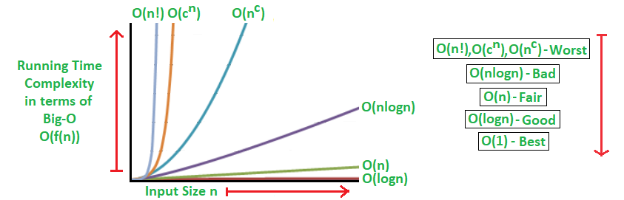
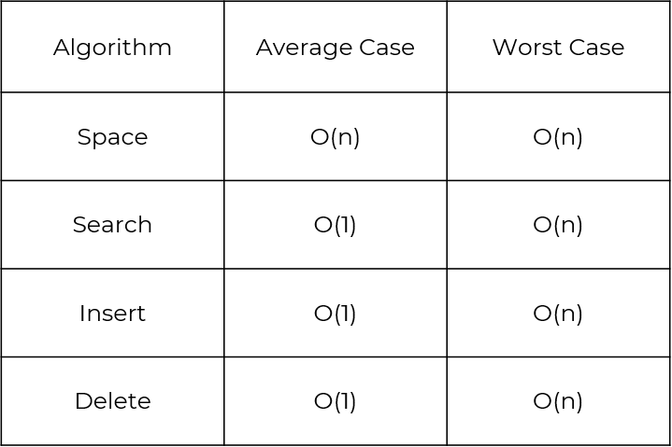

Slide 5
How do they work ?
Hash Tables work by the same principle of 2D array of pointers.
When a key is inserted, the program calls a hashing function to hash the key and get the index of the array, then pushes back the data to the back of a linked list for storing.
This is called a “Hash Table with Chaining”

Slide 6
The Making of a Hash Table

Slide 7
1. Let’s define the hash table
This time I will be using C++ with <bits/stdc++.h> as our library because it has all the things we need in this code
We will be using an array of lists to be the basis of our hash table
Our hash table will have 1000 index numbers and in each index is a linked list to chain all the data.
#include <bits/stdc++.h>
using namespace std;
list <int> table[1000];

Slide 8
2. Hash Function
There are many types of hash function, such as
Identity hash function
Trivial hash function
Folding
Mid-squares
Division hashing
Fibonacci hashing
And so on, and so forth,
The hashing algorithms on the left are complicated so we are going to use a prime number closest to our array as a hash.
For small amounts of data and small integers prime numbers are enough to be the hash.
For more complex keys and bigger numbers a better hash needs to be used in order to avoid too much collision ( A collision is when a data share the same index as another) .
Because our list has 1000 index I used the prime number closest to it hence the 997.

Slide 9
3. Insertion in the hash table
The code on the right shows how we inserted a data to the hash table.
First we set the data type that’s coming in to the list.
Then we scan the data .
We find the index by dividing our data by the hash number (997).
Then we push it into the back of the linked list in that particular index.
Let’s say we want the number 1000 in the hash table, according to the code on the left it will push the data 1000 to the linked list in the index of 3.
int in;
cin >> in;
int key=in % hnum;
table[key].push_back(in);

Slide 10
Insertion
Scan The Data
Divide the data with the hash to get the index.
Insertion
Push it back to the linked list in that index
Look up the array index in the list

Slide 11
4. Search Function
What good is a data structure without the ability to search for a particular data in the structure.
According to the code on the right
First we scan the input with cin and calculate the index of said input.
Then we make an iterator ( in layman’s terms just a pointer with the same data type) and set it to be the start of the linked list with the same index.
It iterates until the end or it breaks until it finds the data on the linked list

Slide 12
5. Deletion
The principle is the same as searching. For deletion all we need to do is :
First thing is to search for the desired data using the search algorithm
When we found the data we use the built in delete function to delete it.

Slide 13
6. Showing all the data
Printing the Hash Table is not hard. Essentially it’s only printing the linked list from the first index to the last index using an iterator.
First we make a loop from 0 to 1000 for all our indexes.
Then iterate from the beginning of our linked lists to the end and print every data inside.

Slide 14
The Actual Code
With some tweaking

Slide 15
#include <bits/stdc++.h>
using namespace std;
list <int> table[1000];
int hnum=997;
int main ()
{
cout << "Hash Table" << endl << "Scanning Query" << endl;
while (1)
{
cout << "(1) Insert (2) Find (3) Delete (4) Show All (0) Exit" << endl;
int query;
cin >> query;
if (query==1)
{
int in;
cin >> in;
int key=in % hnum;
table[key].push_back(in);
}

Slide 16
if (query==2)
{
int in;
cin >> in;
int count=0;
int key=in % hnum;
list<int>::iterator it;
it=table[key].begin();
while (*it!=in && it!=table[key].end())
{
it++;
count ++;
}
if (*it==in)
{
cout << in << " Found on key : " << key << " on index number" << count << endl;
}
if (it==table[key].end())
{
cout << in << " not found :(" << endl;
}
}

Slide 17
if (query==3)
{
int in;
cin >> in;
int key=in % hnum;
list<int>::iterator it;
it=table[key].begin();
while (*it!=in && it!=table[key].end())
{
it++;
}
if(it==table[key].end())
{
cout << in << " Not Found" << endl;
}
else
table[key].erase(it);
}

Slide 18
if (query==4)
{
for (int i=0;i<1000;i++)
{
list<int>::iterator it2;
if (!table[i].empty())
{
it2=table[i].begin();
while (it2!=table[i].end())
{
if (it2==table[i].begin())
{
cout << *it2;
}
else
cout << " --> " << *it2;
it2++;
}
cout << endl;
}
}
}
if (query==0)
{
return 0;
}
}
}

Slide 19
I/O of the Code

Slide 20
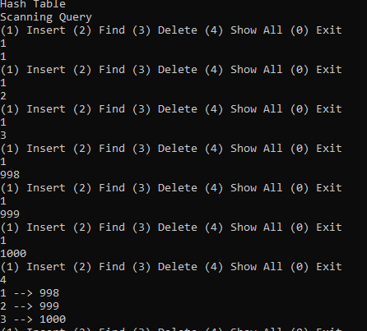

Slide 21
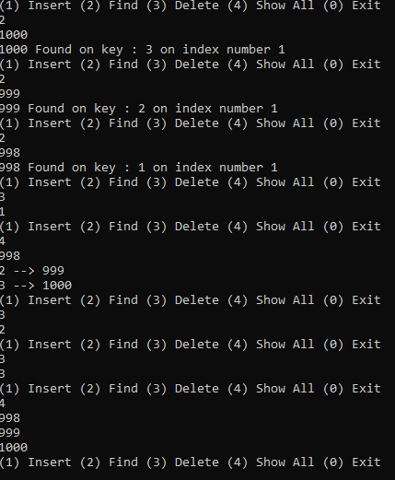

Slide 22
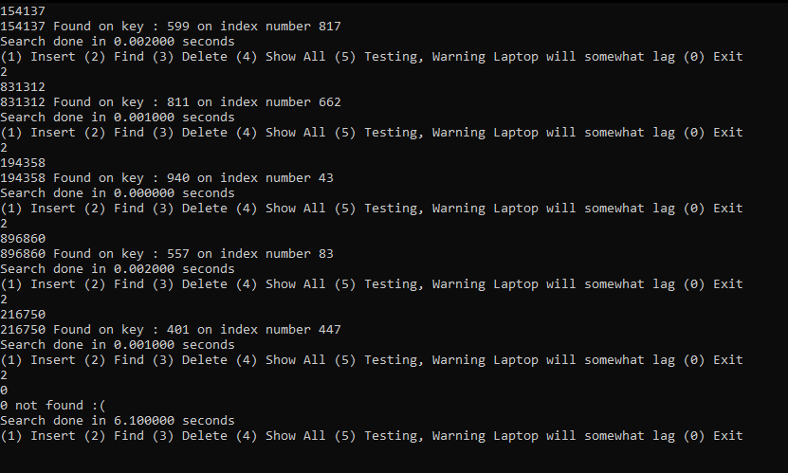

Slide 23
Advantages and Weakness of Hash Table

Slide 24
Advantages and Disadvantages
Main advantage is It’s fast searches and inserts.
In many situations, hash tables turn out to be more efficient than search trees or any other table lookup structure. For this reason, they are widely used in many kinds of computer softwares, particularly for associative arrays, database indexing, caches and sets.
Hash collisions are practically unavoidable. when hashing a random subset of a large set of possible keys.
Hash tables become quite inefficient when there are many collisions.
Hash table does not allow null values, like hash map.
They’re not localized, because of it’s use using linked lists.

Slide 25
Proving Hash Table’s Search Speed

Slide 26
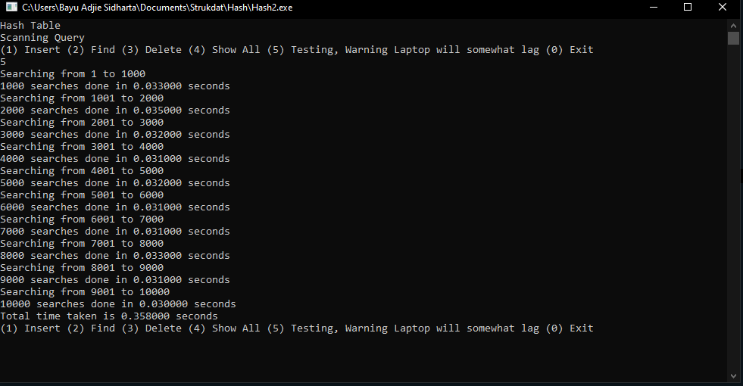
Calculating the search time for Hash Table
Using a random testcase of 10,000 unique numbers ranging from 1 to 10,000 as the control for this experiment, we can see the time it takes to search every number from 1 to 10,000

Slide 27
Data
Range | Time (s)
1 – 1.000 | 0,033000
1.001 – 2.000 | 0,068000
2.001 – 3.000 | 0,100000
3.001 -4.000 | 0,131000
4.001 – 5.000 | 0,163000
Range | Time (s)
5.000 – 6.000 | 0,194000
6.001 – 7.000 | 0,225000
7.001 – 8.000 | 0,258000
8.001 -9.000 | 0,289000
9.001 – 10.000 | 0,319000

Slide 28
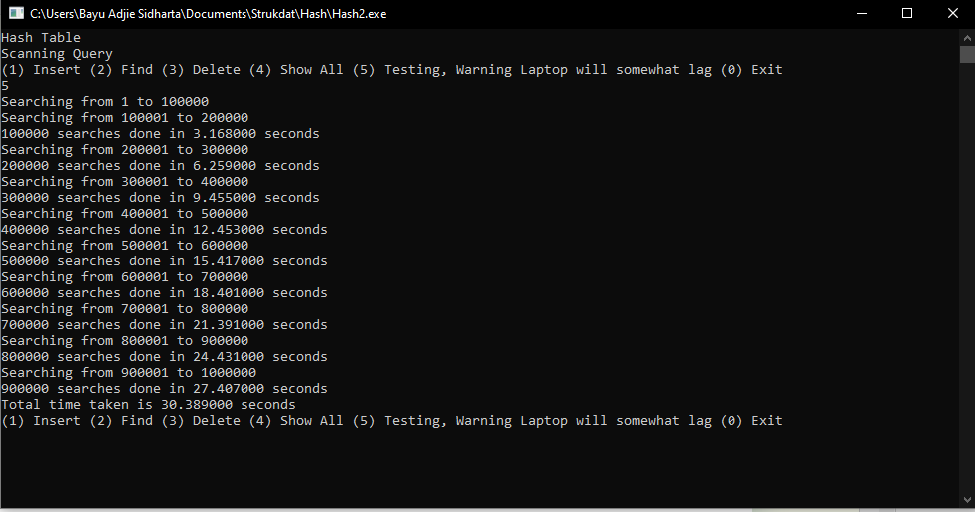
Calculating the search time for 1,000,000 searches
Using a random testcase of 1,000,000 unique numbers ranging from 1 to 1,000,000 as the control for this experiment, we can see the time it takes to search every number from 1 to 10,000,000

Slide 29
Data
Range | Time (s)
1 – 100.000 | 3,16800
100.001 – 200.000 | 6,25900
200.001 – 300.000 | 9,45500
300.001 – 400.000 | 12,45300
400.001 - 500.000 | 15,41700
Range | Time (s)
500.001 - 600.000 | 18,40100
600.001 – 700.000 | 21,39100
700.001 – 800.000 | 24,43100
800.001 -900.000 | 27,40700
900.001 – 100.000 | 30,38900

Slide 30
Quod Erat Demonstrandum
With every 10,000 or 100,000 searches, the time it takes to search is the same with :
Every 1,000 searches taking on average 0,03 seconds.
Every 10,000 searches taking on average 0,3 seconds.
Every 100,000 searches taking on average 3 seconds to do.
This proves that on average the time to search is the same hence the O(1) in the time complexity when searching.

Slide 31
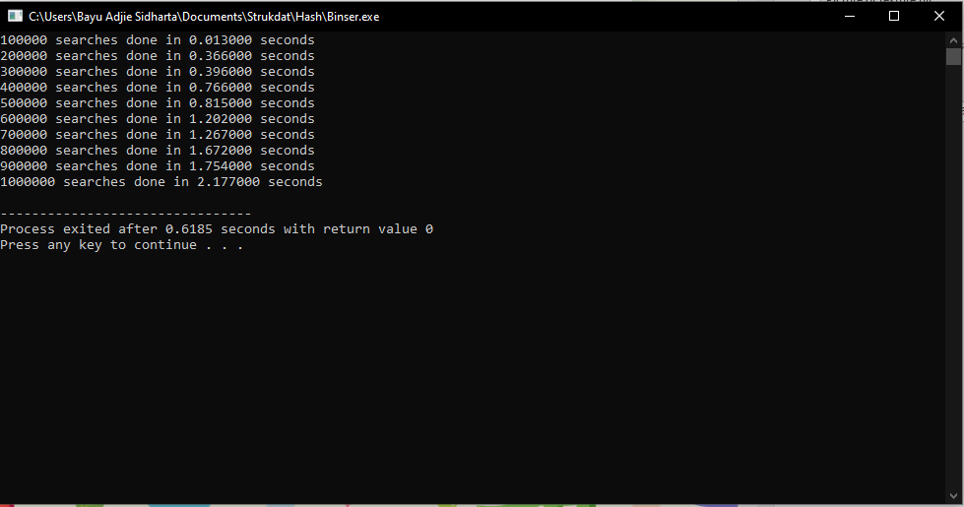
Calculating the search time for 1,000,000 searches with Binary Sort
Using the same input as the hash table searching with a binary search after sorting the array yielded better results. This shows that my implementation of the hash table and hashing function is flawed.

Slide 32
Sorting with a Hash Table
By itself, you cannot sort a hash table. But what you can do is just search the range of all the data in the array and store it in a different array to make a sorted array.
Numbers that have been sorted | 100.000 | 200.000 | 300.000 | 400.000 | 500.000 | 600.000 | 700.000 | 800.000 | 900.000 | 1.000.000
HashTable | 3,168s | 6,259s | 9,455s | 12,453s | 15,417s | 18,401s | 21,391s | 24,431s | 27,407s | 30,389s
HeapSort | 0,027s | 0,059 s | 0,095s | 0,126s | 0,169s | 0,201s | 0,246s | 0,273s | 0,320s | 0,366s
Quicksort | 0,013s | 0,028s | 0,044s | 0,060s | 0,075s | 0,092s | 0,111s | 0,121s | 0,140s | 0,162s
BubbleSort | 27,917s | 113,834s | 257,367s | 456,066s | 716,335s | 1025.406s | Too long | Too long | Too long | Too long
MergeSort | 0,016 | 0,032 | 0,048 | 0,069 | 0,081 | 0,102s | 0,127s | 0,161s | 0,189s | 0,210s

Slide 33
Graph With Bubble Sort

Slide 34
Graph Without Bubble Sort

Slide 35
Graph W/O Bubble and HashTable

Slide 36
If HashSort is Fastest why isn’t it used to sort ?
The reason you've never heard of hash tables being used like this is that hash tables are either "too much" or "not enough" in this situation.
If the range of elements being sorted is small, then you can use counting sort, or something similar. But for counting sort, you would almost certainly want to use a simple array rather than a hash table. If you know the max and min values of the numbers, then the array can be of size max-min+1, and value x would be associated with index x-min. By using an array, you avoid the extra complications of hash tables. Those extra complications are buying you nothing in this application, so hash tables are "too much".
Notice that your "no gaps" restriction ensures that the range of numbers is small (no larger than the number of elements in your original input). However, if gaps can be present then the range of elements is potentially MUCH larger than the number of elements in your original input. Then your running time is dominated by the size of that range, NOT by the size of your original input. Hash tables do not help you deal with those gaps efficiently, so in this case hash tables are "not enough".

Slide 37
Ideas to link a Hash Table with a B+ Tree
What

Slide 38
What to take away
What went right
The actual making of the hash table went smoothly and is capable of handling massive amounts of data by using linked lists.
What went wrong
The in-efficient hashing function, in this case a prime number was the main problem. There was too much collision in the list and that caused slow search times because you can’t binary search a linked list
The lack of a resizing function greatly dampens the performance of the

Slide 39
Thanks!
Any questions? You can find me at line @bayu100020 and bayuaaas@gmail.com

